Slide 1
DAYANANDA SAGAR UNIVERSITY
SCHOOL OF ENGINEERING
Special Topic-II Review 1
HOUSE PRICE PREDICTION
USING MACHINE LEARNING
Under the Supervision of
Dr. Bondu Venkateswarlu
Presented By:
Daniel Thomas(ENG20CS)
Darshan S(ENG20CS)
Vivek Belagali (ENG20CS0414)
Vishwanth Reddy(ENG20CS)

Slide 2
Overview
Abstract
Problem Statement
Introduction
Literature survey
Design
Methodology
References

Slide 3
Abstract
Machine learning plays a major role from past years in image detection, Spam recognition, normal speech command, product recommendation and medical diagnosis along it provides better customer service and safer automobile systems. This shows that ML is trend in almost all fields so we try to coined up ML in our project for betterment. Nowadays, people looking to buy a new home tend to be more conservative with their budgets and market strategies. The current systems main disadvantage is that the calculation of house prices are done without the necessary prediction about future market trends and price increase. The goal of the project is to predict the efficient house pricing for real estate customers with respect to their budgets and priorities. In the present paper we discuss about the prediction of future housing prices that is generated by machine learning algorithm. In-order to select the prediction methods we compare and explore various prediction methods. To predict the future price, the previous market trends, price ranges and also upcoming development will be analyzed. Every year House prices increase , so there is a need for a system to predict house prices in the future. We create a housing cost prediction model in view of Machine Learning algorithm models such as Lasso Regression, Ridge Regression, Ada-Boost Regression, Linear Regression, Decision Tree Regression, Random Forest Regression. House price prediction on a data set has been done by using all the above mentioned techniques to find out the best among them. The developer and customer will be benefited by this model on determining the selling price of a house and helps the latter to arrange the right time to purchase a house.

Slide 4
Problem Statement
The real estate markets present an interesting opportunity for data analysts to analyze and predict where property prices are moving upwards. Prediction of property prices is becoming increasingly important and beneficial. Property prices are a good indicator of both the overall market condition and the economic health of a country. The buyers are just not concerned only about the size(square feet) of the house but there are various other factors that play a key role to decide the price of a house/property. Considering the data provided, we are wrangling a large set of property sales records with unknown data quality issues.

Slide 5
Introduction
In this project, the house price prediction of the house is done using different Machine Learning algorithms like Random Forest Regression, Ridge Regression, LASSO Regression, Decision Tree Regression, XGBoost Regression and we use Ada-Boost algorithm for boosting up the weak learners to strong learners. This work applies various techniques such as variance influence factor, dimensionality reduction techniques and data transformation techniques such as outliers and missing value treatment as well as box-cox transformation techniques. Several factors that are affecting the house price includes the physical attributes, location as well as several economic factors persuading at that time. These all indicate that house price prediction is an emerging research area of regression which requires the knowledge of machine learning.

Slide 6
LITERATURE SURVEY
[1] P. Durganjali, et al., proposed a house resale price prediction using classification algorithms. In this paper, the resale price prediction of the house is done using different classification algorithms like Logistic regression, Decision tree, Naive Bayes and Random forest is used and we use International Journal of Computer Sciences and Engineering Vol.8(7), July 2020, E-ISSN: 2347-2693 © 2020, IJCSE All Rights Reserved 99 AdaBoost algorithm for boosting up the weak learners to strong learners. Several factors that are affecting the house resale price includes the physical attributes, location as well as several economic factors persuading at that time. Here we consider accuracy as the performance metrics for different datasets and these algorithms are applied and compared to discover the most appropriate method that can be used the reference for determining the resale price by the sellers.
[2] Ayush Varma , et al., proposed house price prediction using machine learning and neural networks. Housing prices keep changing day in and day out and sometimes are hyped rather than being based on valuation. Predicting housing prices with real factors is the main crux of our research project. Here we aim to make our evaluations based on every basic parameter that is considered while determining the price. We use various regression techniques in this pathway, and our results are not sole determination of one technique rather it is the weighted mean of various techniques to give most accurate results. The results proved that this approach yields minimum error and maximum accuracy than individual algorithms applied. We also propose to use real-time neighborhood details using Google maps to get exact real-world valuations.

Slide 7
LITERATURE SURVEY
[3] Sifei Lu, et al., proposed a hybrid regression technique for house prices prediction. With limited dataset and data features, a practical and composite data pre-processing, creative feature engineering method is examined in this paper. The paper also proposes a hybrid Lasso and Gradient boosting regression model to predict individual house price. The proposed approach has recently been deployed as the key kernel for Kaggle Challenge “House Prices: Advanced Regression Techniques”. The performance is promising as our latest score was ranked top 1% out of all competition teams and individuals.

Slide 8
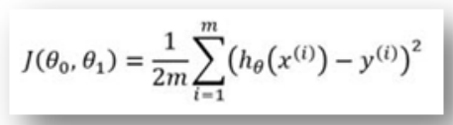
Design approach
Linear regression: Simple linear regression statistical method allows us to summarize and study the relationship between two continuous quantitive variables.
  One variable, denoted x, is regarded as the predictor, explanatory, or independent variable.
  The other variable, denoted y, is regarded as the response, outcome, or dependent variable.
The cost Function: Thus let’s say, you expanded the size of a specific shop, the place you predicted that those deals might a chance to be higher. Be that in spite of expanding those size, those bargains in that shop didn't expand that a great deal. Thereabouts those expense connected Previously, expanding those span of the shop, provided for you negative outcomes. So, we necessity on minimize these cost. So we present an expense function, which is fundamentally used to characterize and measure those slip of the model.

Slide 9
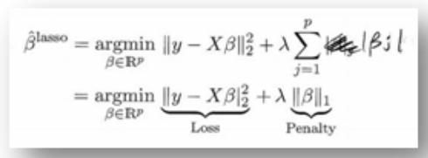
Design approach
C. Lasso Regression
  Lasso regression which may be a standout among those relapse models that would accessible will examine the information. Further, the regression model may be demonstrated for a sample and the formula is Additionally recorded to reference. LASSO stands for Least Absolute Shrinkage and Selection Operator.
  The lasso regression estimate is defined as
  Here the turning component λ controls those quality for penalty, that is. When λ = 0: we get same coefficients Similarly as basic straight relapse. At λ = ∞: constantly on coefficients are zero. The point when 0 < λ < ∞: we get coefficients between 0 What's more that for basic straight relapse thus At λ is amidst the two extremes, we would adjusting those underneath two plans.
    Fitting An straight model for y once X.
    Contracting those coefficients.

Slide 10
Design approach
E. Gradient Boosting algorithm.
  Gradient boosting is a machine Taking in strategy to relapse Also arrangement problems, that produces a prediction model in the structure of an group from claiming powerless prediction models. The exactness of a predictive model might be helped to two ways:. Possibly by grasping characteristic building alternately. Toward applying boosting calculations straight far. There are a significant number boosting calculations in.
    Gradient Boosting
    XGBoost
    AdaBoost
    Gentle Boost etc.

Slide 11
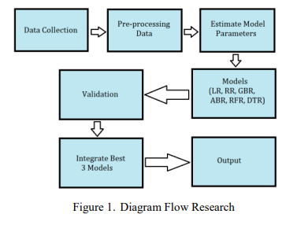

Slide 12
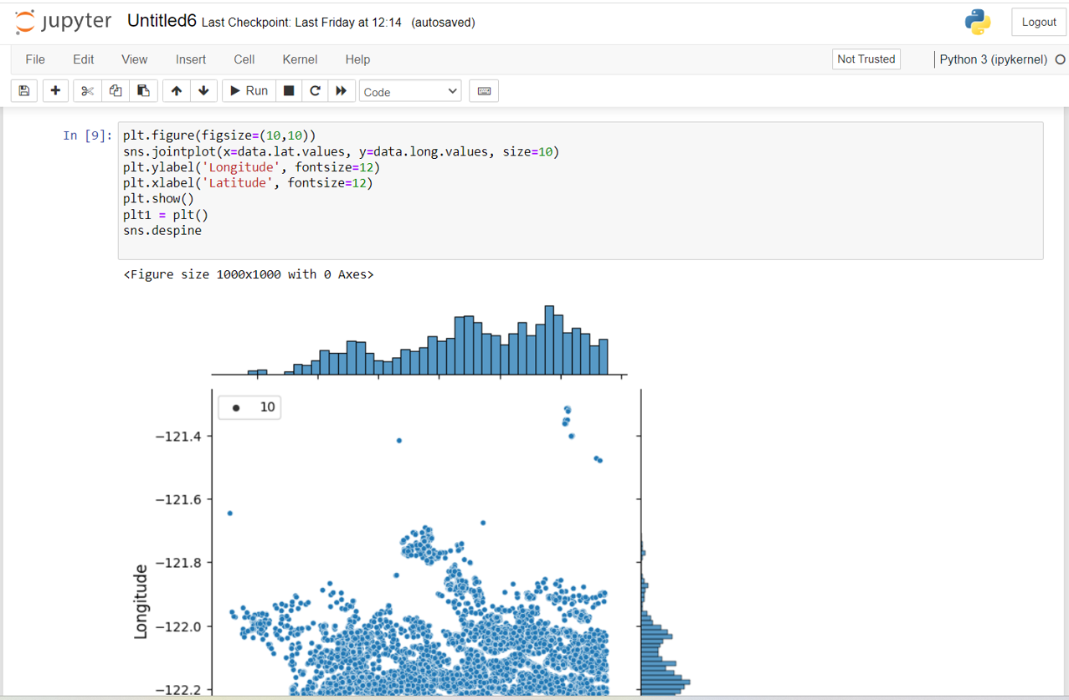

Slide 13
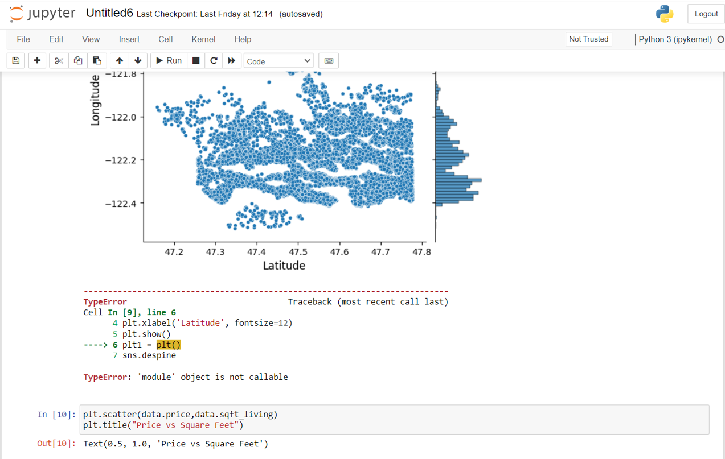

Slide 14
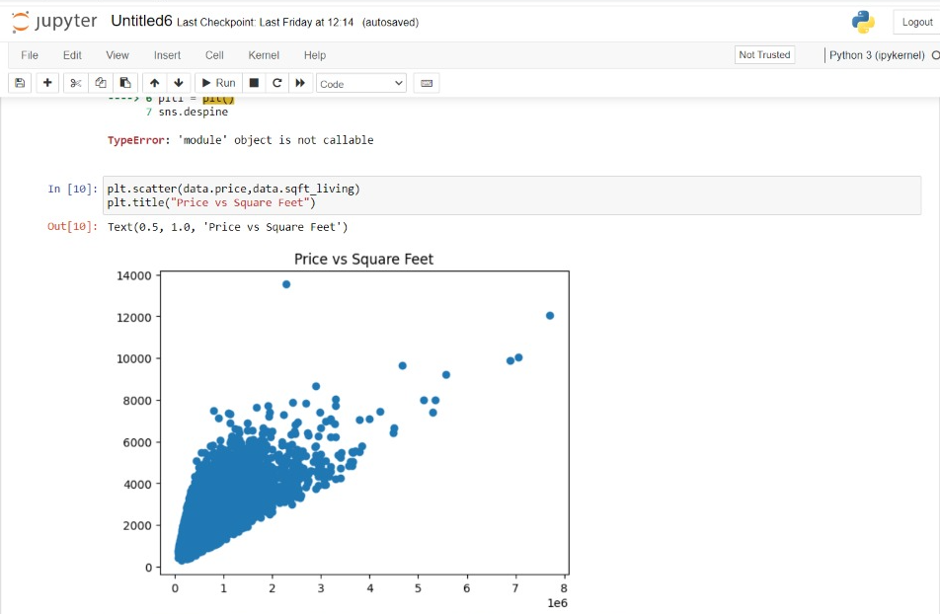

Slide 15

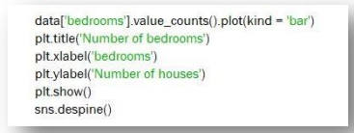
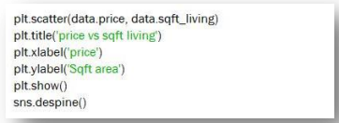
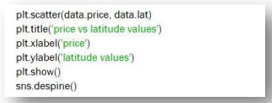
Methodology
Reading the data to plot the graphs:
Using the above data, code to show plot a relation between number of bedrooms and number of houses:
Code to plot relation between Price and Living area:
Plots relation between price and latitudes:

Slide 16
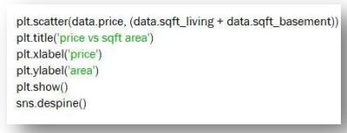
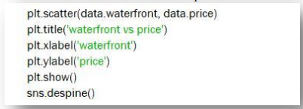
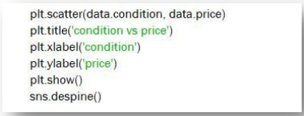
METHODOLOGY
Plots relation between price and area:
Plots relation between waterfront and price:
Plots relation between condition and price:

Slide 17

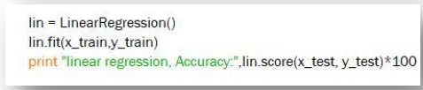
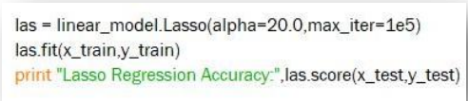
METHODOLOGY
Feeding model with training data:
Training the model with Linear Regression Algorithm:
Training the model with Lasso Regression:
Reading the test data which is dynamically given in excel sheet:

Slide 18
METHODOLOGY (Linear regression) :
Linear regression analysis is used to predict the value of a variable based on the value of another variable.
The variable you want to predict is called the dependent variable. The variable you are using to predict the other variable's value is called the independent variable.
Linear regression is commonly used for predictive analysis and modeling. For example, it can be used to quantify the relative impacts of age, gender, and diet (the predictor variables) on height (the outcome variable).
Linear regression is used to determine the character and strength of the association between a dependent variable and a series of other independent variables. It helps create models to make predictions, such as predicting a company's stock price.

Slide 19
References

